Slide 1

School of Computer Science & Engineering
Course Code: BTCS2041 Course Name: Computer Graphics
UNIT-2
2D Transformation
Faculty Name: Subhash Chandra Gupta Program Name: B.Tech

Slide 2
Recapitulations
2D Transformation
Scaling
Rotation

Slide 3
Objectives
2D Transformation
Homogenous Coordinates
Shearing
Reflection

Slide 4
Why use 3x3 matrices?
Homogeneous Coordinates
So that we can perform all transformations using matrix/vector multiplications
This allows us to pre-multiply all the matrices together
The point (x,y) needs to be represented as (x,y,1) -> this is called Homogeneous coordinates!

Slide 5
Homogenous Coordinates
Homogenous Coordinates - term used in mathematics to refer to the effect of this representation on Cartesian equations.
Converting a pt(x,y) and f(x,y)=0 -> (x_{h},y_{h},h) then in homogenous equations mean (v*x_{h},v*y_{h},v*h) can be factored out.
What you should get: By expressing the transformations with homogenous equations and coordinates, all transformations can be expressed as matrix multiplications.

Slide 6
2 x 2 Matrix
Translation: x’ x tx
y’ y ty
Rotation: x’ cos(θ) -sin(θ) x
y’ sin(θ) cos(θ) y
Scaling: x’ Sx 0 x
y’ 0 Sy y
= +
= *
= *

Slide 7
3 x 3 Matrix Representation
Translation:
Rotation:
Scaling:
x’ 1 0 tx x
y’ = 0 1 ty * y
1 0 0 1 1
x’ cos(θ) -sin(θ) 0 x
y’ sin(θ) cos(θ) 0 * y
1 0 0 1 1
=
x’ Sx 0 0 x
y’ = 0 Sy 0 * y
1 0 0 1 1

Slide 8
Shearing in x
Shearing
Y coordinates are unaffected, but
X coordinates are translated linearly with y
That is:
y’ = y
x’ = x + y *h
x 1 h 0 x
y = 0 1 0 * y
1 0 0 1 1

Slide 9
Shearing in Y
Shearing in y :
Y coordinates are unaffected, but x coordinates are translated linearly with y
That is:
y’ = y
x’ = x + y *h
x 1 0 0 x
y = g 1 0 * y
1 0 0 1 1
Interesting Facts:
Any 2D rotation can be built using three shear transformations.
Shearing will not change the area of the object
Any 2D shearing can be done by a rotation,
followed by a scaling, and followed by a rotation

Slide 10
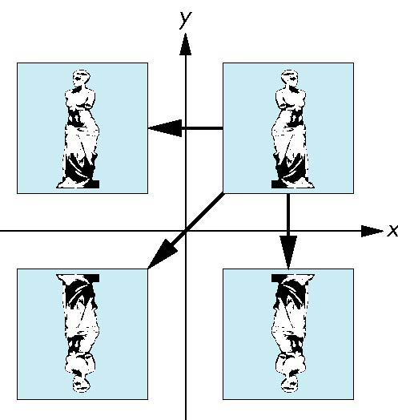
Reflection
Reflection :
s_{x} = -1 s_{y} = 1
original
s_{x} = -1 s_{y} = -1
s_{x} = 1 s_{y} = -1

Slide 11
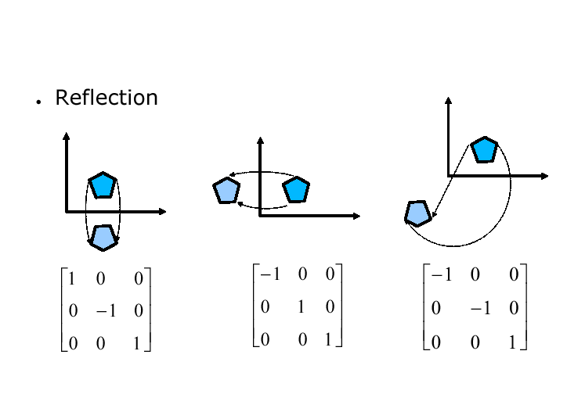
Reflection

Slide 12
Rotation Re-visit
The standard rotation matrix is used to rotate about the origin (0,0)
cos(θ) -sin(θ) 0
sin(θ) cos(θ) 0
0 0 1
What if I want to rotate about an arbitrary center?

Slide 13
Arbitrary Rotation Center
To rotate about an arbitrary point P (px,py) by q:
Translate the object so that P will coincide with the origin: T(-px, -py)
Rotate the object: R(q)
Translate the object back: T(px,py)
(px,py)

Slide 14
Arbitrary Rotation Center
Translate the object so that P will coincide with the origin: T(-px, -py)
Rotate the object: R(θ)
Translate the object back: T(px,py)
Put in matrix form: T(px,py) R(θ) T(-px, -py) * P
x’ 1 0 px cos(θ) -sin(θ) 0 1 0 -px x
y’ = 0 1 py * sin(θ) cos(θ) 0 * 0 1 -py * y
1 0 0 1 0 0 1 0 0 1 1

Slide 15
Scaling Revisit
The standard scaling matrix will only anchor at (0,0)
Sx 0 0
0 Sy 0
0 0 1
What if I want to scale about an arbitrary pivot point?

Slide 16
Arbitrary Scaling Pivot
To scale about an arbitrary pivot point P (px,py):
Translate the object so that P will coincide with the origin: T(-px, -py)
Scale the object: S(sx, sy)
Translate the object back: T(px,py)
(px,py)

Slide 17
References
1. https://www.tutorialspoint.com/computer_fundamentals/index.htm
2. A brief history of programming languages www.site.uottawa.ca › handouts › notes › 02_History

Slide 18
subhash.chandra@galgotiasuniversity.edu.in
THANKS

